Slide 1
PREDICTING ALLERGY DEVELOPMENT WITH MACHINE LEARNING
DTSC 691 – HANNA HALFINGER

Slide 2
WHAT WE WILL COVER
The Rise of Allergies
Potential Causes and Factors
Machine Learning Web App
Code Walkthrough
Web App Demonstration
Insights and Outcomes

Slide 3
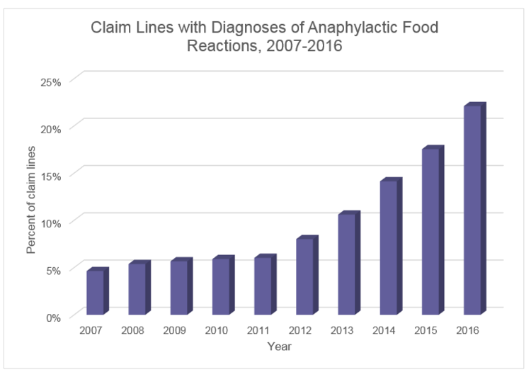
THE RISE OF ALLERGIES
Allergies affect 1 in 3 adults in the U.S.
Food allergies in children increased by 50% between 1997 and 2011 [1]
Approximately 30–40% of the world's population now suffers from some form of allergy [3]
[2]
Notes:
Allergies are a common health issue that affects billions worldwide, with about 1 in 3 adults in the U.S. experiencing allergies. Similar trends are observed globally, and reports indicate that the prevalence of food allergies in children increased by 50% between 1997 and 2011 ("Allergies, 2023"). Approximately 30–40% of the world's population now suffers from some form of allergy (Davies, 2023).

Slide 4
POTENTIAL CAUSES AND FACTORS
Dietary changes towards processed foods
Too little exposure to potential allergens early in life
Chemical exposure from cleaning & hygiene products

Slide 5
THE SOLUTION

Slide 6
MACHINE LEARNING WEB APP
Trained to predict the likelihood of developing allergies based on potential causes and factors

Slide 7
DATASET USED
The dataset was obtained by the European Social Survey, an international survey conducted in 2023, that included over 22,000 participants across 31 European countries. The survey involved an hour-long face-to-face interview

Slide 8
FEATURES ANALYZED
47 features including lifestyle factors such as:
Diet
Physical activity
Smoking & drinking habits
Other health problems
Treatments used in last 12 months
Exposure to pollutants growing up and in job
Type of area lived in (e.g. big city, town, farm)
Occupation & industry worked in
Total household income

Slide 9
MACHINE LEARNING MODELS
Logistic Regressor
Random Forest Classifier
Support Vector Classifier
XG Boost Classifier

Slide 10
REFERENCES
[1] “Allergies Are Getting More Common. Playing in the Dirt Could Help.” Memorialhermann, 28 July 2023, memorialhermann.org/health-wellness/health/allergies-getting-more-common.
[2] Bloom, Dave. “Private Insurance Claims Related to Anaphylaxis from Food Allergy Have Nearly Quadrupled since 2007.” SnackSafely.Com, 21 Aug. 2017, snacksafely.com/2017/08/private-insurance-claims-related-to-food-allergy-induced-anaphylaxis-have-nearly-quadrupled-since-2007/.
[3] Davies, Dave. “Why Our Allergies Are Getting Worse -and What to Do about It.” NPR, NPR, 30 May 2023, www.npr.org/sections/health-shots/2023/05/30/1178433166/theresa-macphail-allergic-allergies.

